Slide 1
Heart Stroke - Prediction Analysis
Harini Prabha Baskar Jayanthi
Salma Chanbasha Nandikotkur
Prathyusha Parimi
Sandhya Sree Agolu
Satish Tirumalapudi
Anwar Shaikh

Slide 2
Introduction
Heart Stroke is one of the severe health hazards; therefore, early heart stroke prediction helps the society to save human lives.
This objective can be achieved using the machine learning techniques.
In this project, machine learning models are applied on well known heart stroke classification data-set.

Slide 3
Data Source(Working Data set):
After thorough research we were able to find a dataset that could help us this analysis and prediction.
The dataset named Heart Stroke(healthcare-dataset-stroke-data.csv) is used to predict the heart stroke in a human and is for educational research purpose.
Link: https://www.kaggle.com/fedesoriano/stroke-prediction-dataset/metadata

Slide 4
Input/Output variables :
The dataset we choose has 11 columns of different attributes that are considered for stroke detection.
The input variables are id, gender, age, hyper_tension, heart_disease, ever_married, work_type, residence_type, average_glucose_level, BMI, smoking_status .
The output variable(Dependent variable) is “Stroke” which is 0/1.

Slide 5
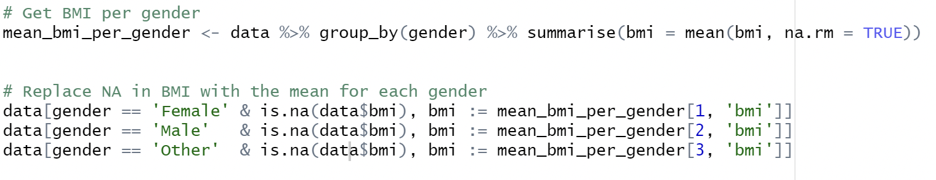
Data Preprocessing:
Replacing the Missing Values with Mean in BMI
Dropping the irrelated features(ID)

Slide 6
Data Transformation:
One-Hot encoding:
One Hot Encoding creates a new binary feature for each possible category and assigns a value of 1 to the feature of each sample that corresponds to its original category. For this dataset One-hot encoding is used to deal with categorical variables.
To overcome imbalance data we performed oversampling
That is MWMOTE (Majority Weighted Minority Oversampling Technique) for oversampling the stroke class and reduce class imbalance.
oversampled <- mwmote(data, classAttr = "stroke", numInstances = 500) oversampled <- round(oversampled)

Slide 7
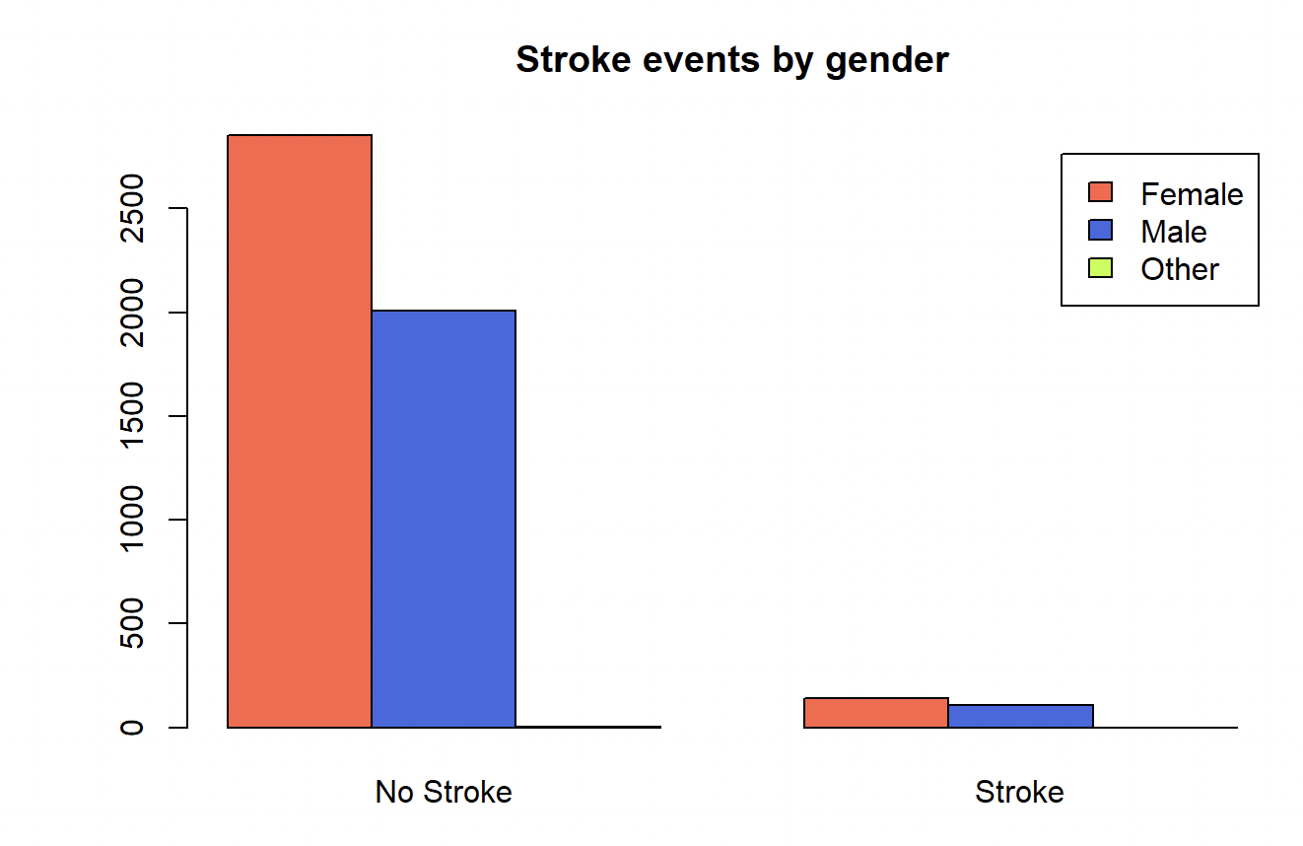
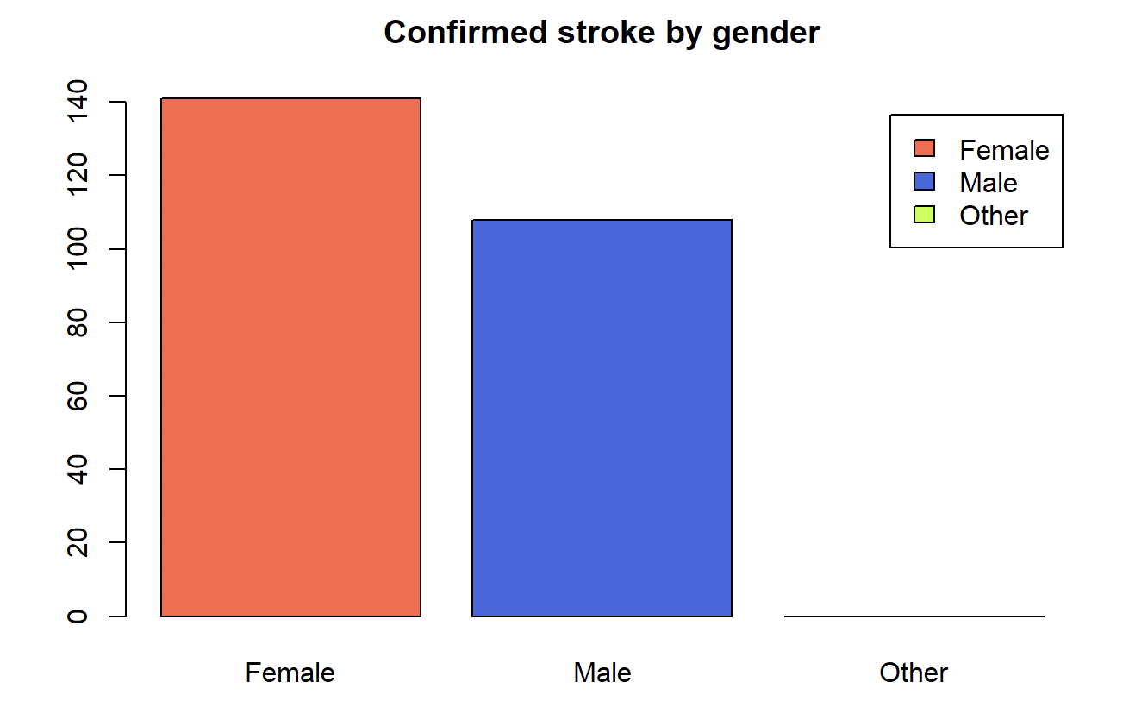
Exploratory Data Analysis:
Comparing the stroke events based on patient’s gender

Slide 8
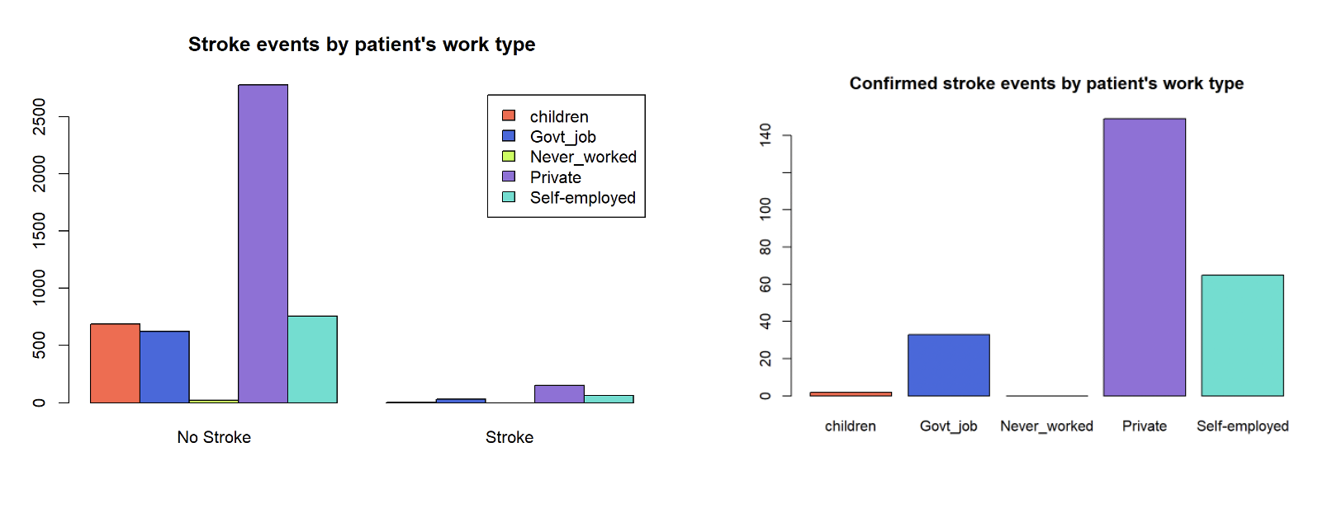
Work type vs Stroke events
Influence of work_type in stroke events

Slide 9
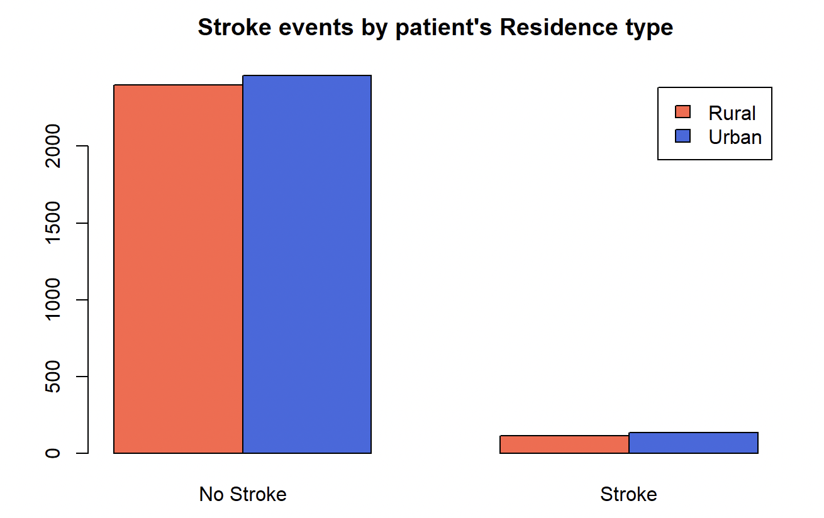
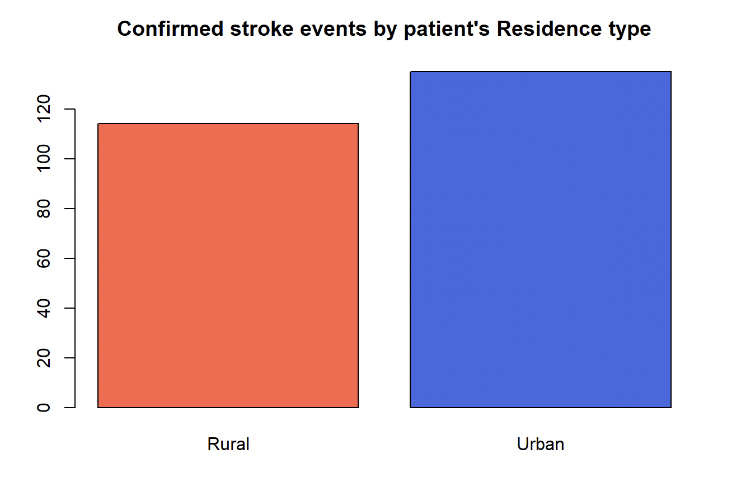
Residence vs Stroke events
Comparing the residence of patients with confirmed stroke events

Slide 10
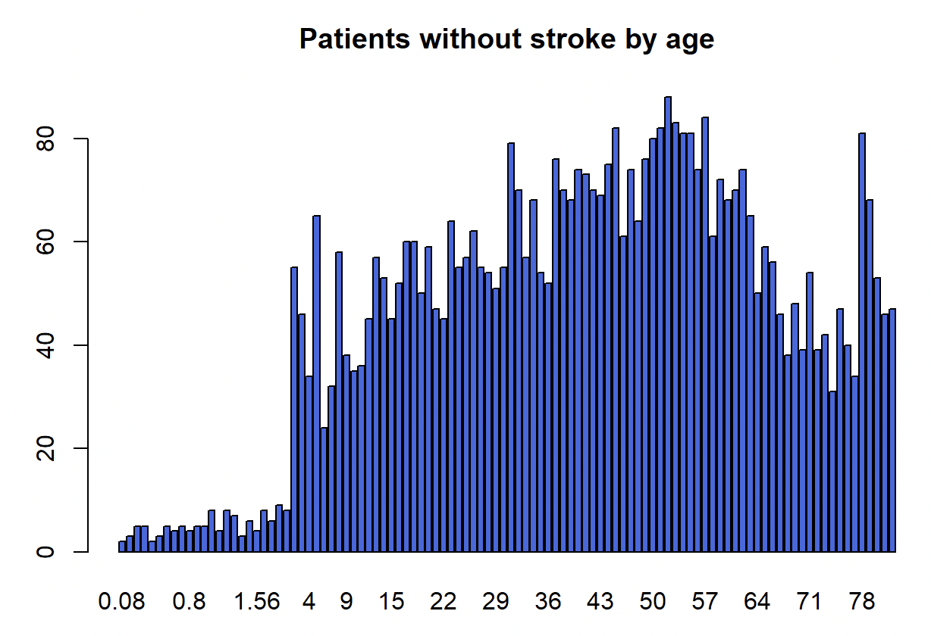
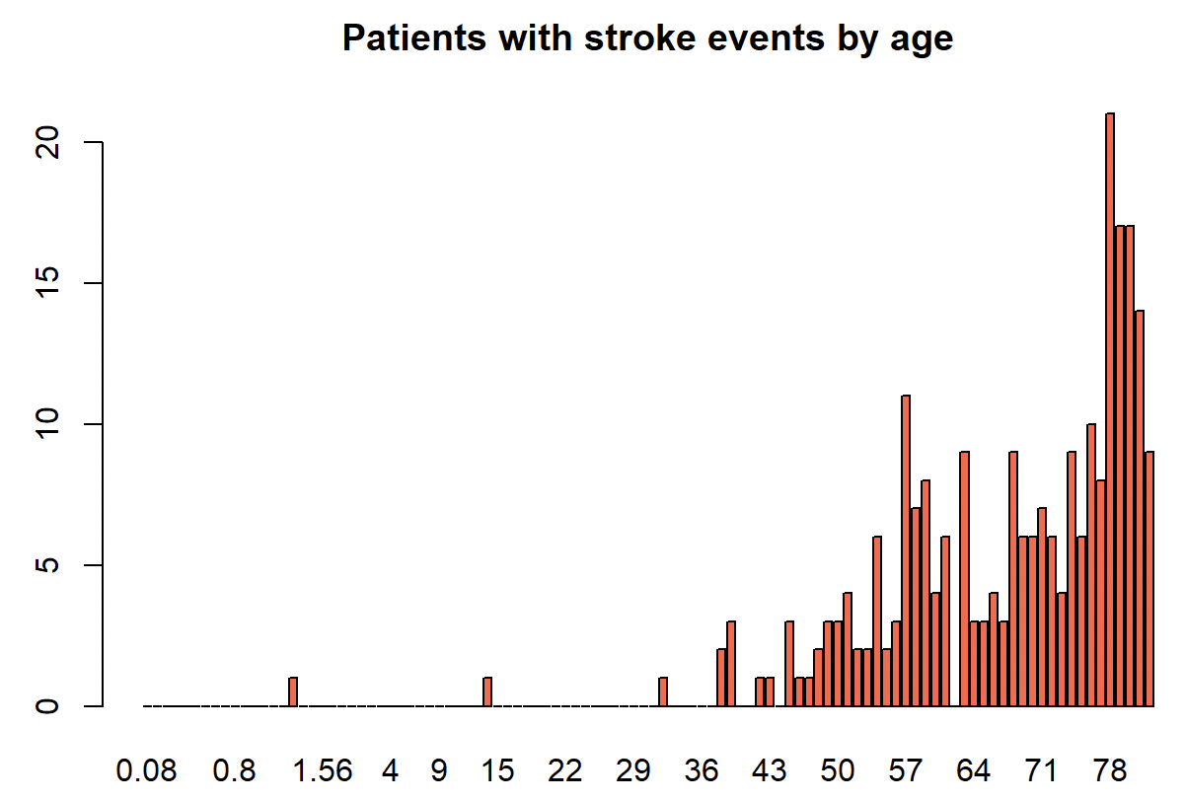
Age vs Stroke events
Patients with stroke events by Age

Slide 11
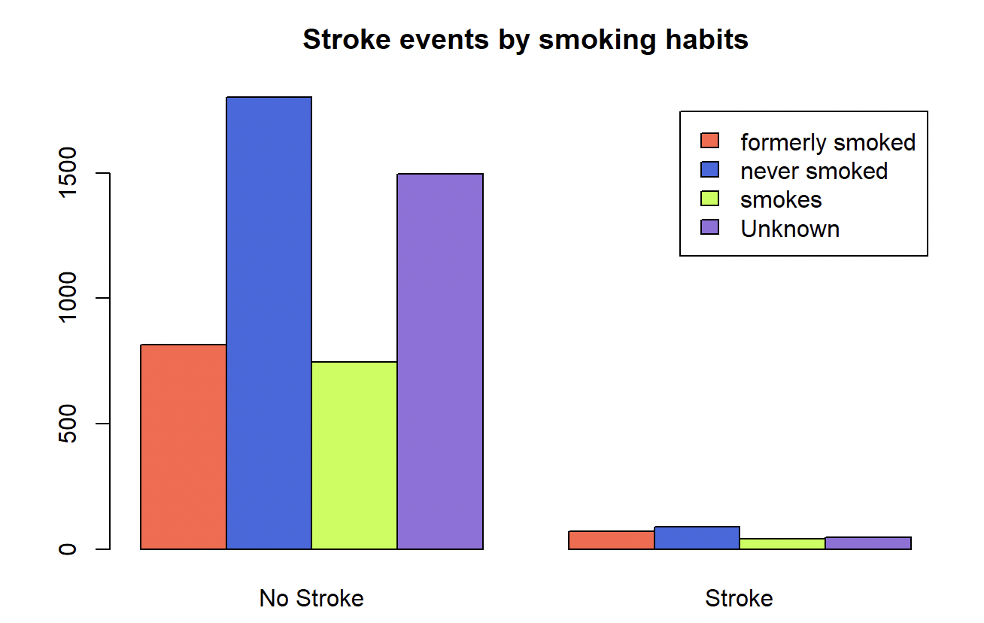
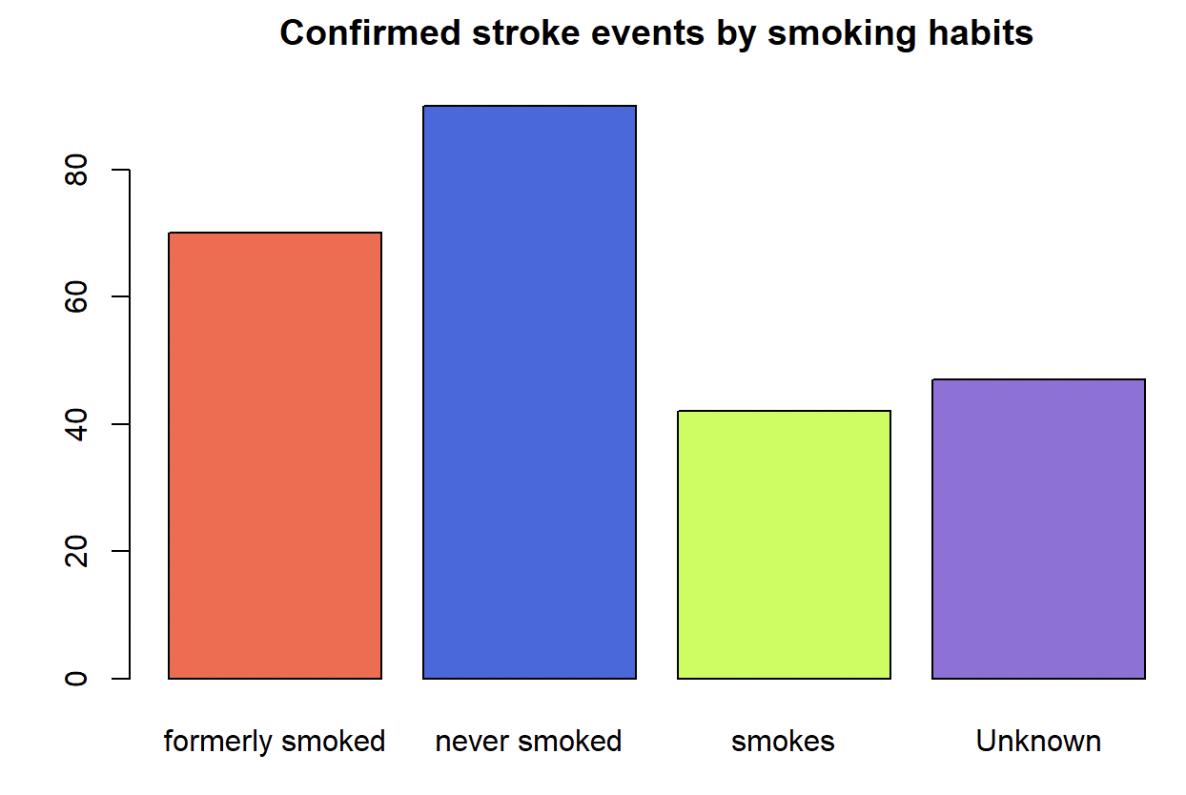
Smoking habits vs Stroke events
The relation between smoking habits and stroke events

Slide 12
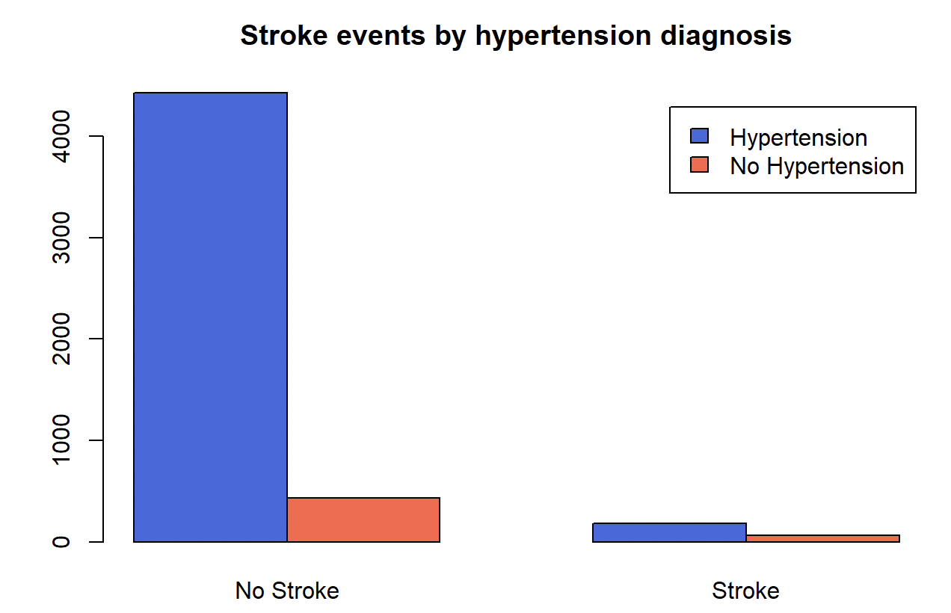
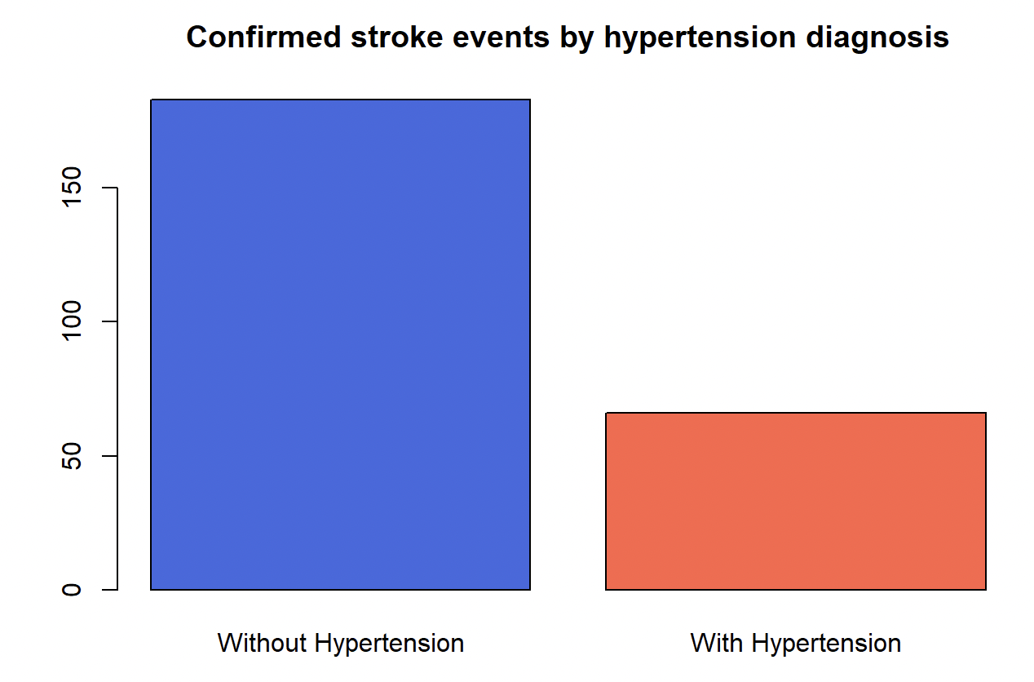
Hyper tension vs Stroke event
compare the hypertension factor with stroke events now

Slide 13
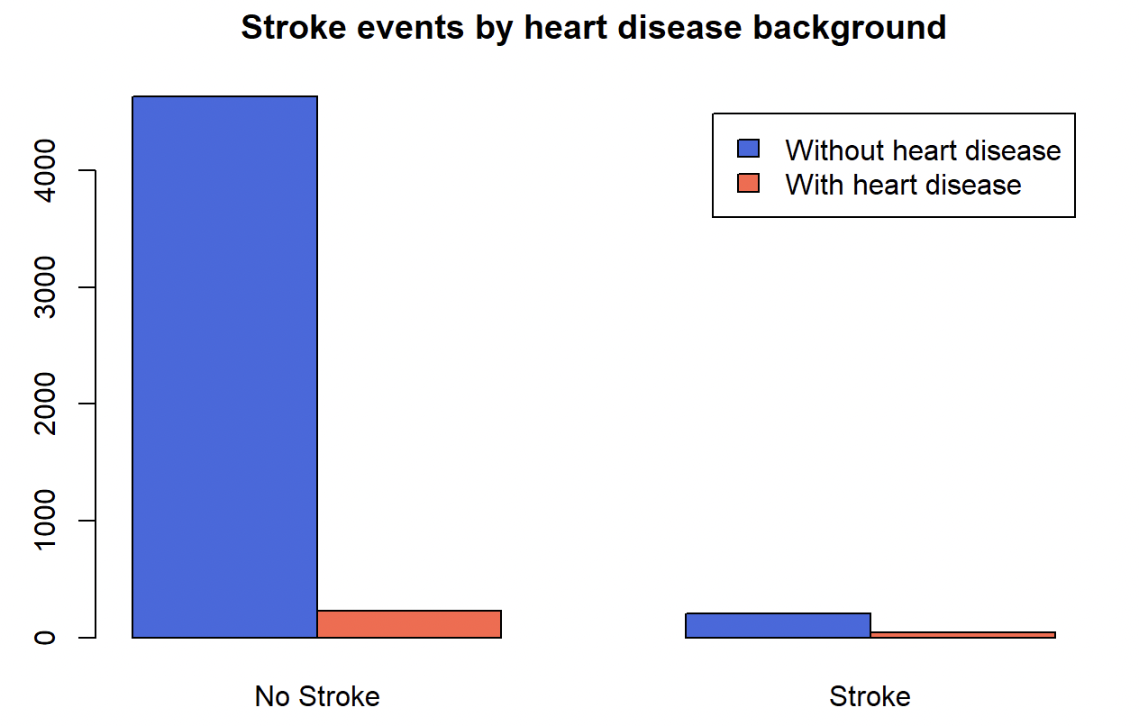
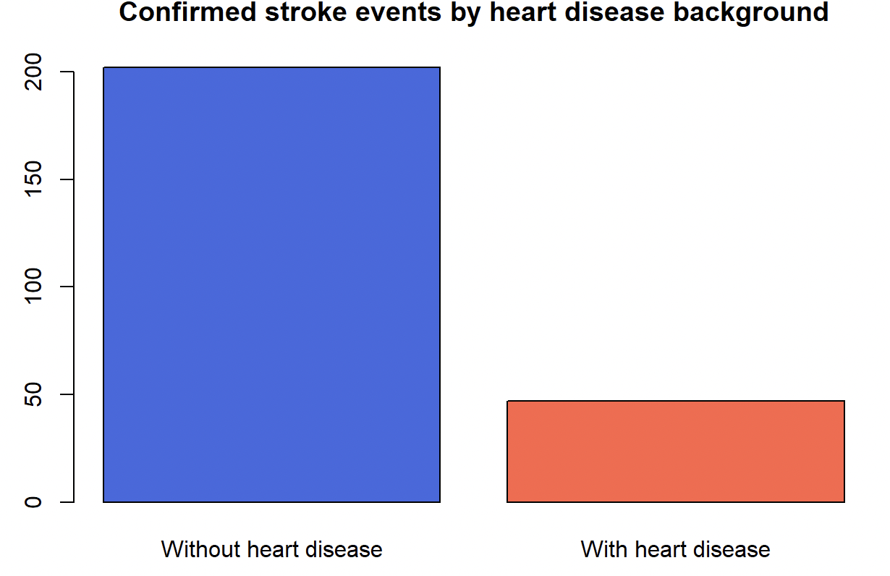
The comparations of stroke events and a heart disease background

Slide 14
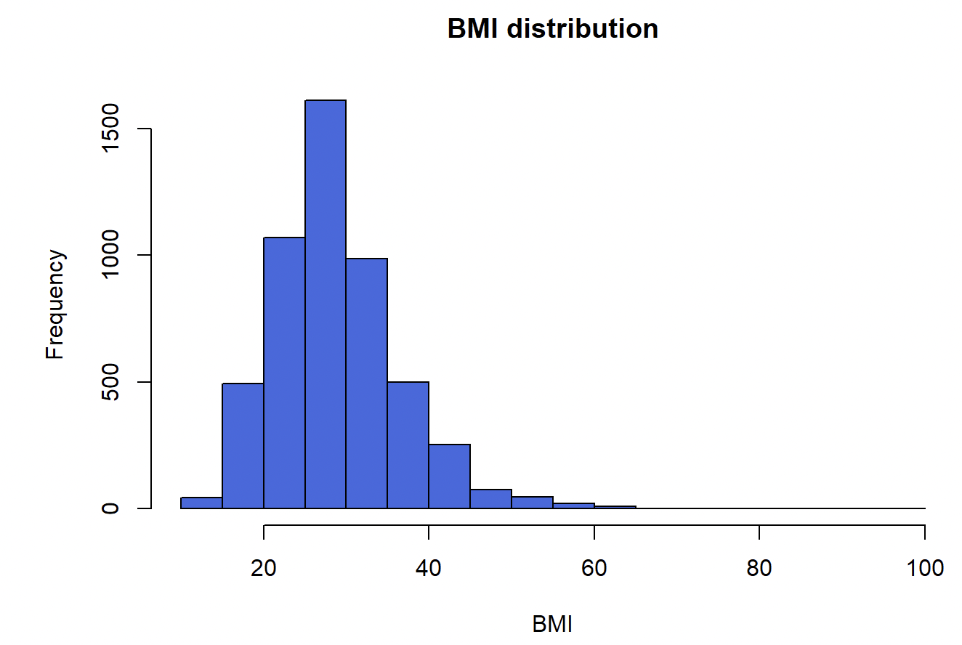
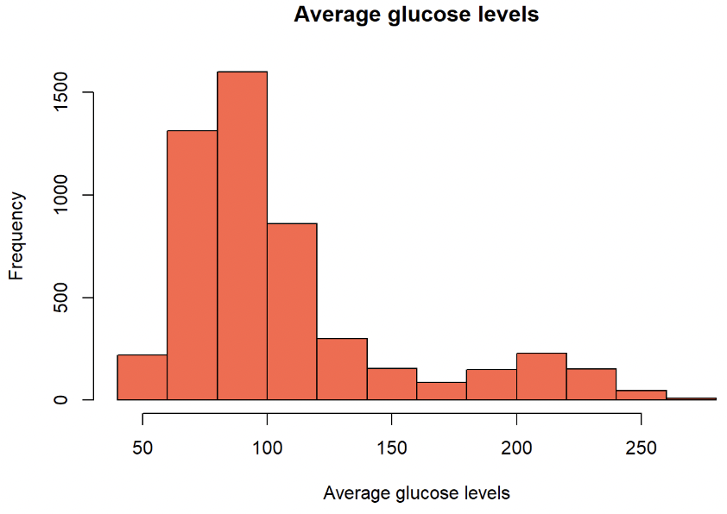
Distribution of BMI and the average glucose level of patients

Slide 15
ML Models
The Machine learning models we applied for this dataset are:
Logistic Regression
Random Forests
K-Nearest Neighbor
Neural Networks
Ensemble using weighted average

Slide 16
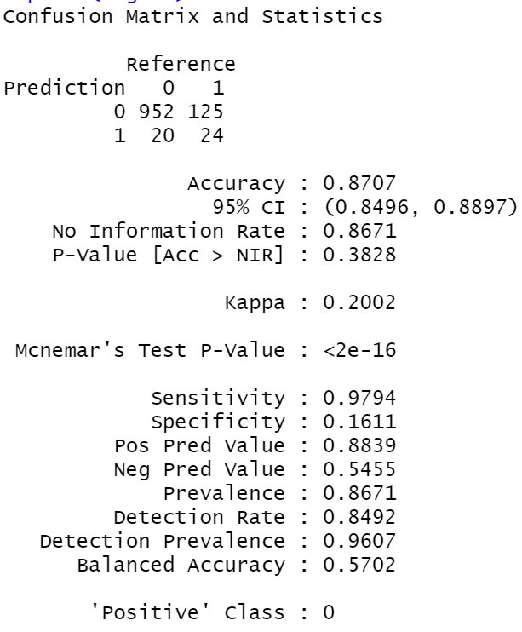
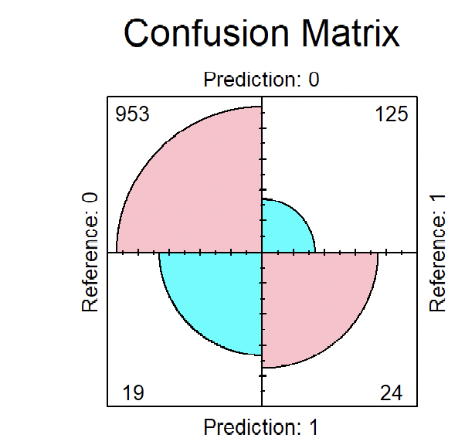
LOGISTIC Regression

Slide 17
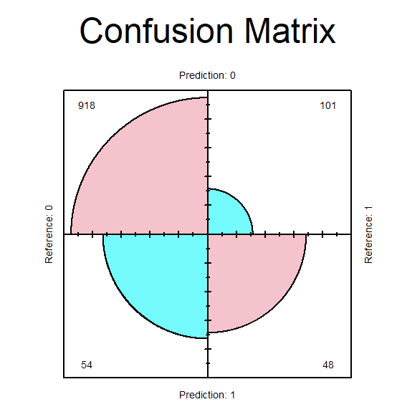
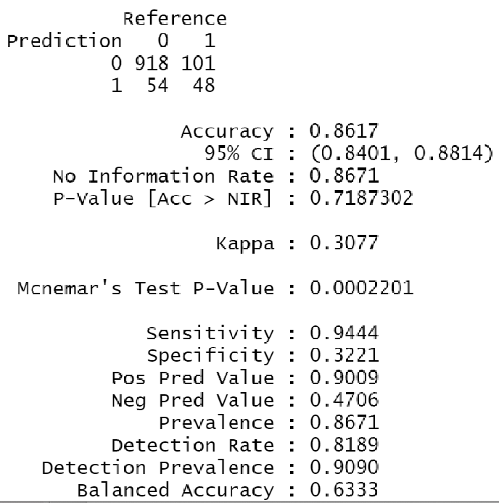
KNN

Slide 18
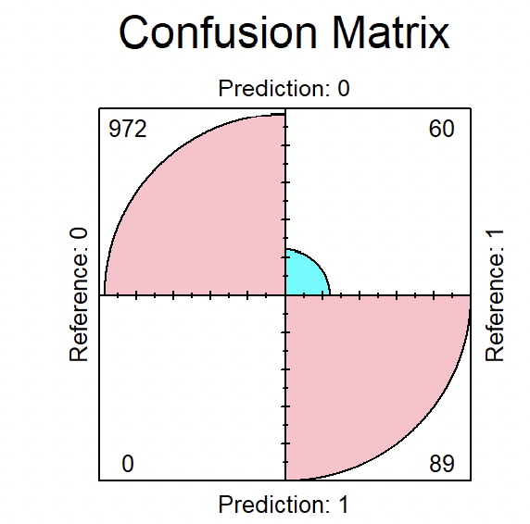
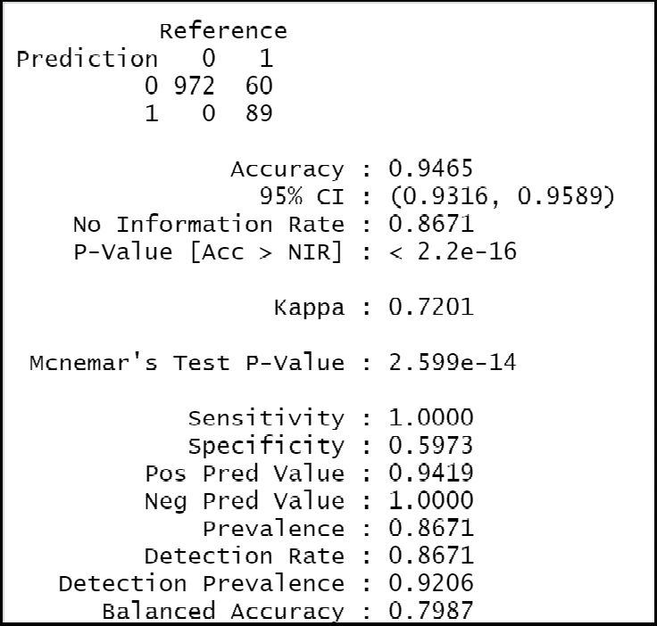
Random Forest:

Slide 19
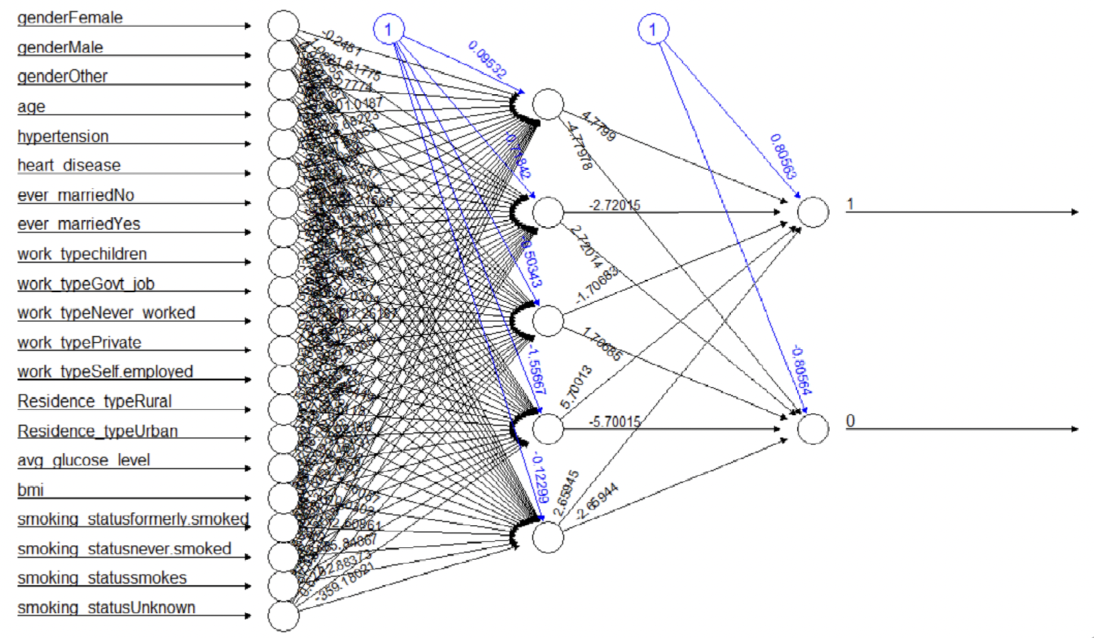
NEURAL NETWORK

Slide 20
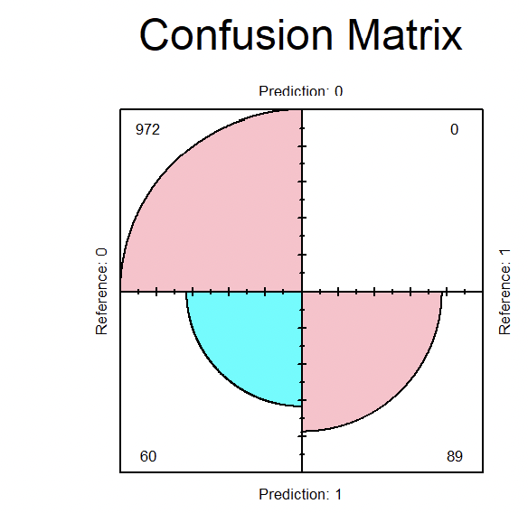
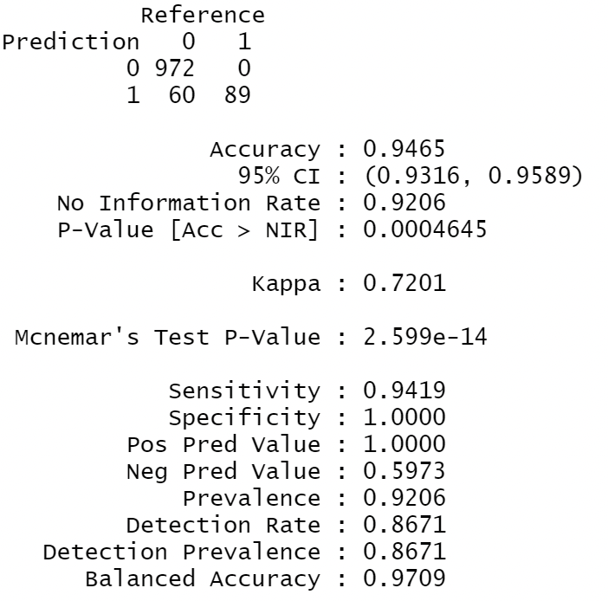
Ensemble Model:

Slide 21
Conclusion:
Age is a major risk factor for stroke. As we get older we are more at risk to suffer a stroke.
Males and females both suffer stroke at a similar rate. However, females have been shown to suffer strokes at younger ages than males.
Heart problems like hypertension and heart disease greatly increase the risk of stroke.
People who have been married are at a higher risk of stroke. This may be due to higher levels of stress that occur during married life.
We got better accuracy while using the Random Forest Machine learning model of 94.65
To improve variance and bias we used weighted average and got an accuracy of 94.65

Slide 22
Thank you

